Slide 1


TEMBO HOTEL
PERFORMANCE ANALYSIS REPORT
A comprehensive data-driven review of booking performance, revenue trends, customer behavior, and operational efficiency — Luxdev Cohort 7 Group 2 Evening
Derick Menje – Group Leader
Ibrahim Njuguna
Justus Wagura
Noel Mwami
Clinton Onduko
Kenneth Kipng’etich
Salome Chemutai
Lenny Maina

Slide 2

PRESENTATION OVERVIEW
This analysis walks through four key stages of the project — from data sourcing and cleaning through to actionable strategic recommendations for Tembo Hotel management.
03
INTRODUCTION & PROJECT GOALS
04
DATA OVERVIEW
05
DATA CLEANING PROCESS
06
FINDINGS: KEY PERFORMANCE DASHBOARD
07
FINDINGS
08
FINDINGS
09
FINDINGS
10
KEY INSIGHTS
11
STRATEGIC
RECOMMENDATIONS
12
CONCLUSION
GROUP 2 E | TEMBO HOTEL ANALYSIS
02

Slide 3




INTRODUCTION & PROJECT GOALS
This project analyzes Tembo Hotel's booking dataset to uncover revenue trends, understand customer behavior, and evaluate operational performance. The raw data required significant cleaning before meaningful analysis could be conducted.
FOUR CORE PROJECT GOALS
CLEAN DATA
REVENUE TRENDS
CUSTOMER BEHAVIOR
OPERATIONS
Clean the raw hotel booking data to ensure analytical reliability and accuracy.
Evaluate operational performance including staff contribution and room efficiency.
Generate insights on revenue patterns across time periods and room types.
Understand guest booking patterns, origins, and preferences.
GROUP 2 E | TEMBO HOTEL ANALYSIS
03

Slide 4


DATA OVERVIEW
The source data was a CSV file containing approximately 285 booking records.
It captured five core data domains essential for a full-picture hotel performance analysis.
DATA QUALITY ISSUES
Duplicate Booking IDs Creates inflated metrics and revenue
■
DATA DOMAIN
FIELDS INCLUDED
Inconsistent Formats For phone numbers, dates, and cities
■
Dates, nights stayed, booking status
Booking Details
Missing & Blank Values Across several key fields
Name, phone, nationality, city of origin
■
Guest Details
Room number, room type, room rates
Inconsistent Labels For room categories (e.g., Std vs Standard)
■
Room Data
Staff name, department, monthly salary
Staff Data
Currency Formatting Stored as text with symbols
■
Payment method, total amount, service price
Payments
GROUP 2 E | TEMBO HOTEL ANALYSIS
04

Slide 5




DATA CLEANING PROCESS
The raw dataset contained structural problems that would have made any analysis misleading without cleaning. Three primary issues were prioritized for correction before analysis began.
01
02
03
DUPLICATE BOOKING IDS
INCONSISTENT DATES
TOTAL AMOUNT FORMATS
THE RISK
THE RISK
Makes time-based and seasonal analysis impossible.
THE RISK
Could severely inflate revenue figures and booking counts.
Unreliable financial aggregation and mathematical errors.
THE SOLUTION
THE SOLUTION
Standardized all date fields and converted them to proper SQL date types.
THE SOLUTION
Deduplicated records into a clean staging table.
We cleaned by removing symbols and converting them into numeric values to enable accurate aggregation
CREATE table cleaned_staging_booking1 AS SELECT DISTINCT * FROM cleaned_staging_booking;
GROUP 2 E | TEMBO HOTEL ANALYSIS
05

Slide 6
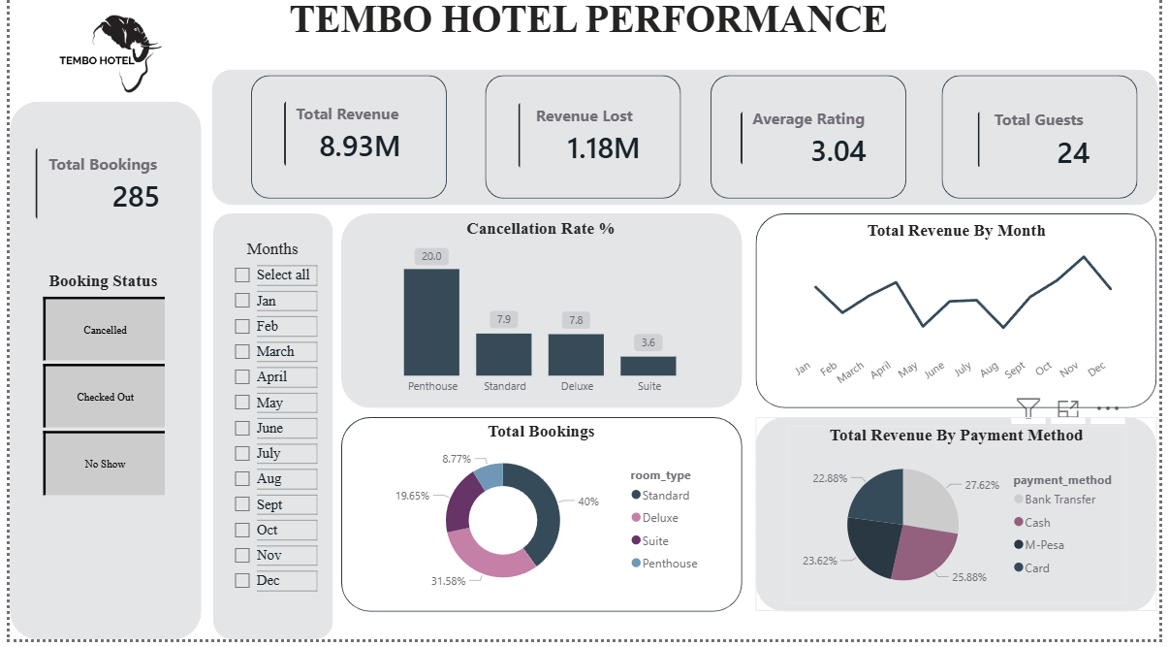
FINDINGS: Key Performance Dashboard
GROUP 2 E | TEMBO HOTEL ANALYSIS
06

Slide 7
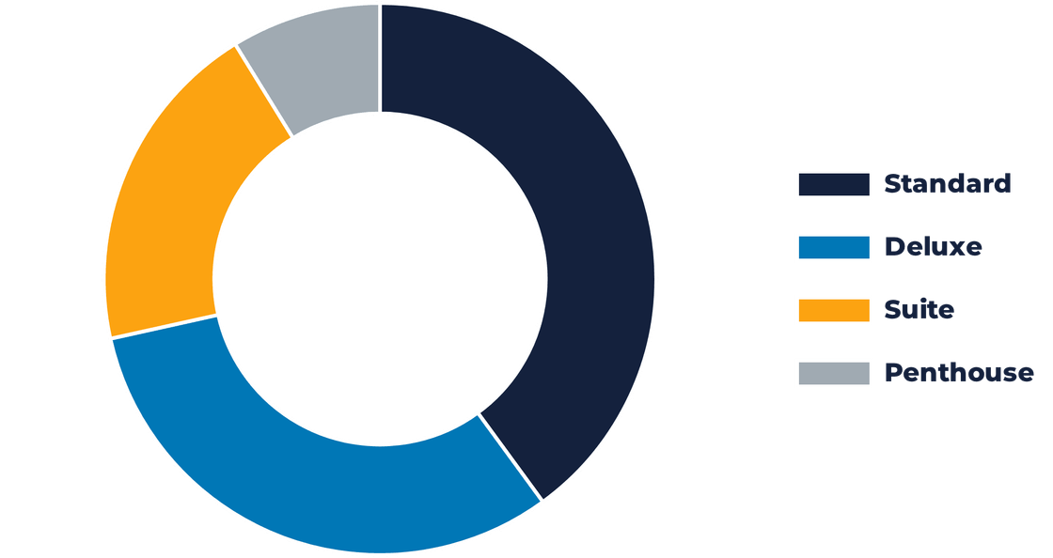

FINDINGS…
TOTAL REVENUE
Overall Performance Insight
Total revenue collected was 8.93 million
Total bookings were 285
A significant amount,1.18 million ,was lost in revenue due to cancellations
a majority of the customers being return customers
KES 8.93M
BOOKINGS BY ROOM TYPE
Booking analysis – Room preference by booking
Standard: (40%) - Most popular
Deluxe: (31.6%)
Suite: (19.7%)
Penthouse: (8.8%)
SEASONALITY INSIGHTS
Monthly revenue analysis:
November was the strongest month at KES 973,100
August recorded the lowest at KES 563,000
Peak Month (Nov)
KES 973,100
Lowest Month (Aug)
KES 563,000
Revenue Swing
~42% Variance
GROUP 2 E | TEMBO HOTEL ANALYSIS
07

Slide 8

FINDINGS…
The combined monthly payroll was KES 414,000 across 8 employees,
staff performance varies significantly.
The top three revenue-generating staff collectively contributed over KES 3.77M
This is nearly 42% of total hotel revenue.
TOP 3 REVENUE-GENERATING STAFF
JOYCE OTIENO
KES 1.37M
BRENDA ACHIENG
KES 1.28M
TOTAL MONTHLY PAYROLL (8 STAFF)
KES 414,000
KES 1.12M
FATUMA HASSAN
Performance-based incentives could unlock further revenue growth, especially since the highest-rated employee is paid the highest.
RISK IDENTIFIED: Heavy reliance on a few top performers creates significant revenue concentration risk if they leave the organization.
GROUP 2 E | TEMBO HOTEL ANALYSIS
08

Slide 9

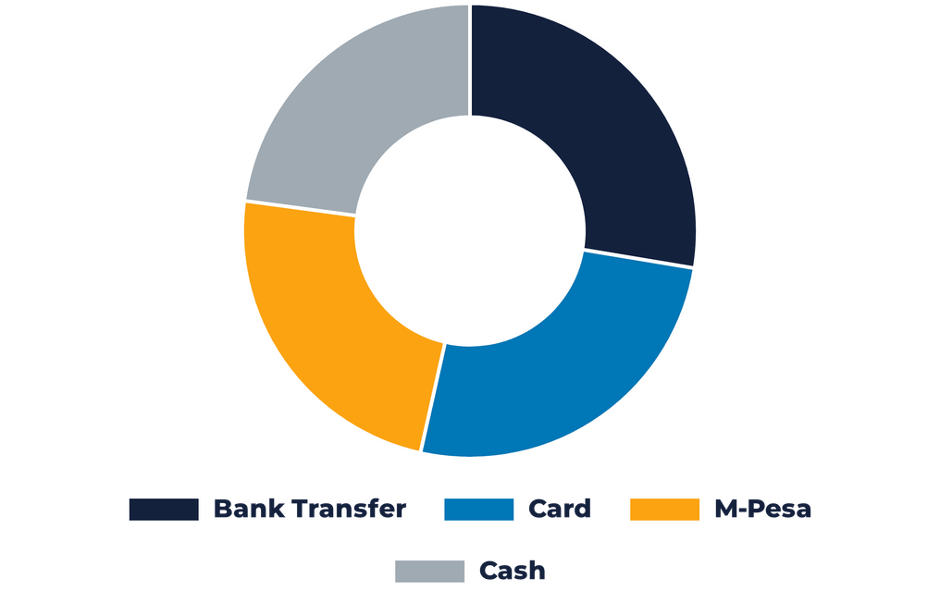
FINDINGS
REVENUE BY PAYMENT METHOD
Revenue is distributed relatively evenly across four payment methods, suggesting no single channel dependency.
GEOGRAPHIC CONCENTRATION
Guest origin data reveals a heavy concentration from Nairobi, with secondary cities like Thika making up a much smaller portion of the customer base.
THE RISK
Over-reliance on a single city creates vulnerability to local economic shifts. Geographic diversification is needed to ensure long-term stability.
GROUP 2 E | TEMBO HOTEL ANALYSIS
09

Slide 10







KEY INSIGHTS: WHAT THE DATA REVEALS
Synthesizing the findings across revenue, rooms, staff, and guest data reveals six interconnected patterns that define Tembo Hotel's current performance landscape.
NAIROBI DEPENDENCY
LUXURY UNDERPERFORMANCE
PENTHOUSE CANCELLATIONS
Over-reliance on a single city for guest sourcing creates significant geographic market vulnerability.
Demand is heavily skewed toward affordable Standard rooms; Penthouse sits at only 8.8% occupancy.
A severe 20% cancellation rate for Penthouses compared to just 3.6% for Suites.
RETURN CUSTOMER RELIANCE
THE RATING GAP
REVENUE CONCENTRATION
Average rating of 3.04/6 is above average but well below competitive hospitality benchmarks.
Majority of bookings come from repeat guests, indicating weak new customer acquisition channels.
Top 3 staff generate a disproportionate share of revenue; a major risk if they depart.
GROUP 2 E | TEMBO HOTEL ANALYSIS
10

Slide 11
STRATEGIC RECOMMENDATIONS
Based on the data, the prioritized recommendations address revenue leakage, geographic concentration, guest satisfaction, and operations.
PRIORITY
STRATEGIC ACTION
TARGETED OUTCOME
HIGH
Staff Incentives:
Tie incentives to guest ratings.
Raise avg rating to 4.0+.
HIGH
Peak Readiness:
Staff & inventory for Nov peaks.
Capture peak-month revenue.
HIGH
Penthouse Review:
Adjust pricing & booking rules.
Reduce 20% cancellations.
HIGH
Geo-Expansion:
Market to cities beyond Nairobi.
Diversify guest origin.
MEDIUM
Loyalty Program:
Launch a repeat-guest program.
Improve retention.
MEDIUM
Room Promotions:
Push Standard & Deluxe.
Increase volume in top categories.
MEDIUM
Guest Experience:
Enhance service & amenities.
Boost ratings & positive reviews.
LOW
Capacity Planning:
Reassess Penthouse inventory.
Meet potential luxury demand.
GROUP 2 E | TEMBO HOTEL ANALYSIS
11

Slide 12



CONCLUSION
MOVING FORWARD WITH CONFIDENCE
Tembo Hotel has a solid revenue base (KES 8.93M) but faces clear challenges in cancellations, guest ratings, and luxury-room performance. Prioritized, data-driven actions will reduce losses and build resilience.
FINAL TAKEAWAYS
Clean data is the foundation of reliable decisions.
Grow revenue by retaining customers and targeting new segments.
Invest strategically in staff, rooms, and targeted marketing.
PRESENTED BY GROUP 2 E | TEMBO HOTEL PERFORMANCE ANALYSIS
12

